Slide 1

Royal University of Phnom Penh
Faculty of Science
Department of Computer Science
Subject : Data Structures & Algorithms
Topic : Employee Management System
Instructor : Ung Rithy
Group 4
Plong Rotha ( Leader)
Sreang Rathana ( Co-Leader)
Pheap Piseth
Phiv Lyhou
Nuon Touchvathna
Phorng Phanu

Slide 2
Employee Management
System

Slide 3
Table of Contents
What is Employee Management System
01
02
Top Down Design
03
Stepwise Refinement by S.L.L
04
Source code using C\C++

Slide 4
What is Employee Management System
01
An Employee Management System (EMS) is a software application or a system designed to streamline and automate various human resources (HR) functions related to managing employees within an organization. It helps HR departments and managers handle tasks more efficiently by organizing employee data, tracking performance, and facilitating various HR-related processes.
Core Functions of an Employee Management System :
Employee data management: Personal Information, Employment Details…
Attendance & Time Tracking: Clock in, Clock out…
Payroll Management: Salary Calculations, Tax Management…

Slide 5
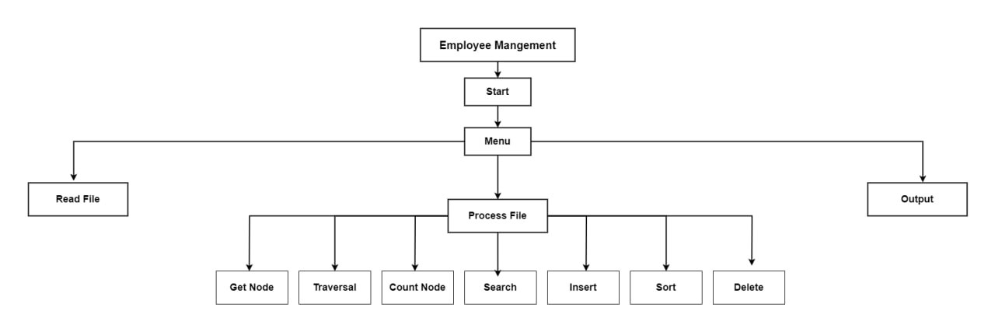
02
Top Down Design

Slide 6
Step in Creating a Top Down Design :
Identifying the Input and Output problem and all necessary requirements
For this problem, we have divided it into 3 steps :
Store each of employee’s problem in a file and name it Read file
Provide understandable solutions to all requirements and name it Process file
Output all employee’s information and name it Output

Slide 7
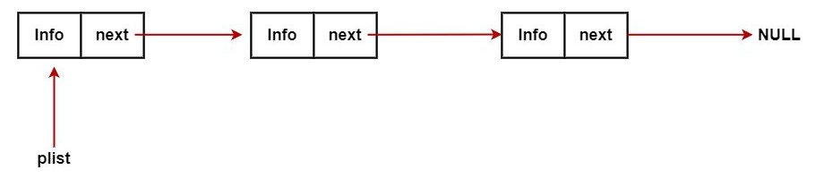
03
Stepwise Refinement by S.L.L

Slide 8
Algorithm
Start
Create a Struct
Create a struct called emp_data for a singly linked list. It contains:
An integer empno
Two char arrays empName and designation
A pointer next to the next node.
Create Pointer Variable
Create a pointer variable p of type struct emp_data.
Declare Pointer temp
Declare a pointer temp of type struct emp_data.
Allocate Memory
Allocate memory for temp
If temp is NULL, print "Allocation failed"

Slide 9
Insert Function
Create a function for inserting employee records in the linked list:
Store id, name, and designation in temp
Set temp->next to front
Set front to temp
Return front
Print Function
Create a function for printing records:
Print all the employee data stored in p
Delete Function
Create a function to delete records:
Declare two pointer variables ptr and bptr of type struct emp_data

Slide 10
Delete Function
Compare the id given by the user with ids in the system. If the given id is present in the list:
Set ptr to front
Print the deleted node and display "Node deleted"
Set plist to plist->next
Free ptr
Set ptr to plist->next and bptr to plist
Traverse the list: ptr = ptr->next and bptr = bptr->next
For ptr != NULL, if the given id is present in the list:
Print the deleted node
Set bptr->next to ptr->next
Free ptr
If given id is not present in the list, print "Employee number not found"

Slide 11
Display Function
Create a function to display records:
Declare a pointer ptr of type struct emp_data
Starting from the beginning of the list, print all records until the end of the list is reached
Main function
Take choice input from the user
● If user chooses option 1:
○ If the linked list is empty, print: List is empty.
○ Call the function ‘display’ to display records

Slide 12
Main function
● If user chooses option 2:
○ If the linked list is empty, count list is Empty.
○ call the function ‘count’ to count records.
● If user chooses option 3:
○ Take the employee number of employees whose record is to be searched
○ Call the function ‘search’ to search for the employee’s details
● If user chooses option 4:
○ Take employee details from user
○ Call the function ‘insert’ for inserting employee records in the linked list

Slide 13
Main function
● If user chooses option 5:
○ Take employee number of records to be deleted as input, from the user
○ Call the function ‘deleteNode’ for deleting records from the list
● If user chooses option 6:
○ Take employee number of records to be insert,
○ Call the function ‘SortAsc’ for sorting records from the list
● If user chooses option 7:
○ Take employee number of records to be insert as input,
○ Call the function ‘SortAsc’ for sorting records from the list

Slide 14

Main function
● If user chooses option 8:
○ Exit the program
○ If the user choose any other option , print “Invalid option .Please try again.
○ Stop

Slide 15
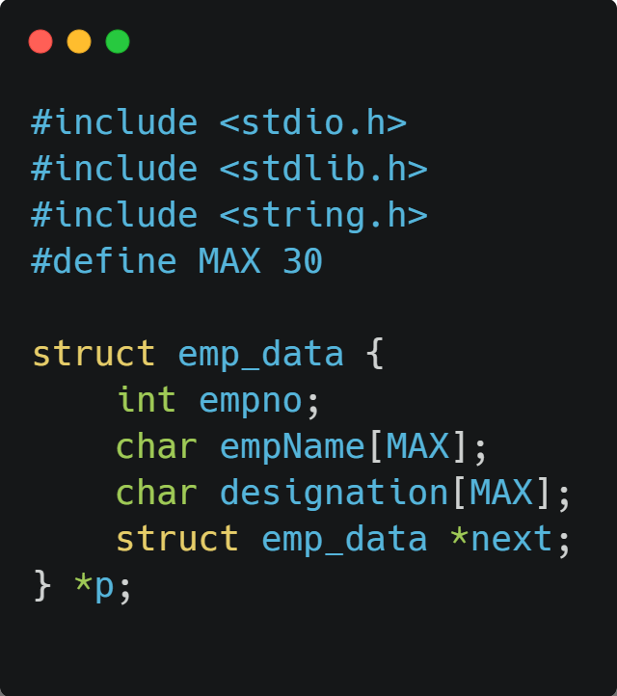
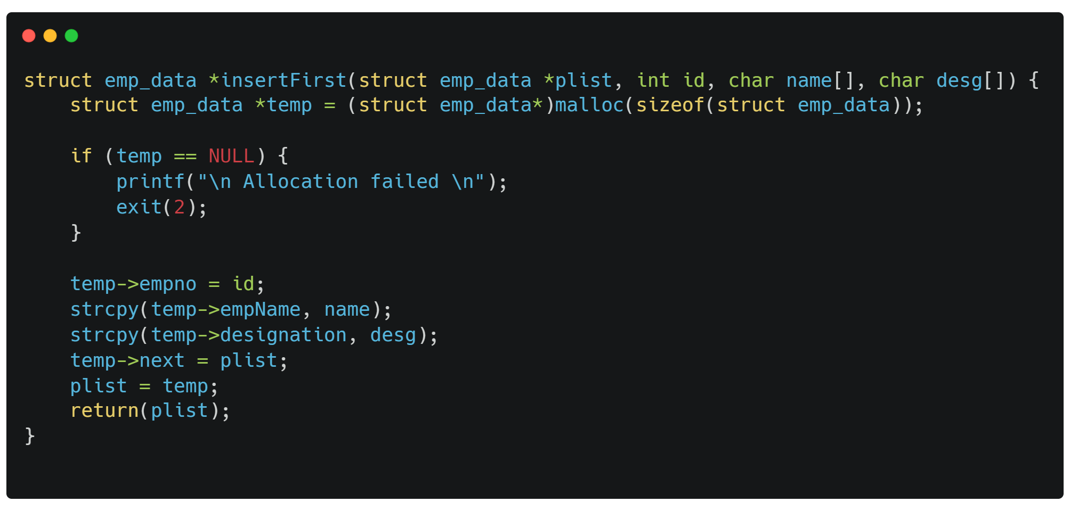
04
Source code using C\C++

Slide 16
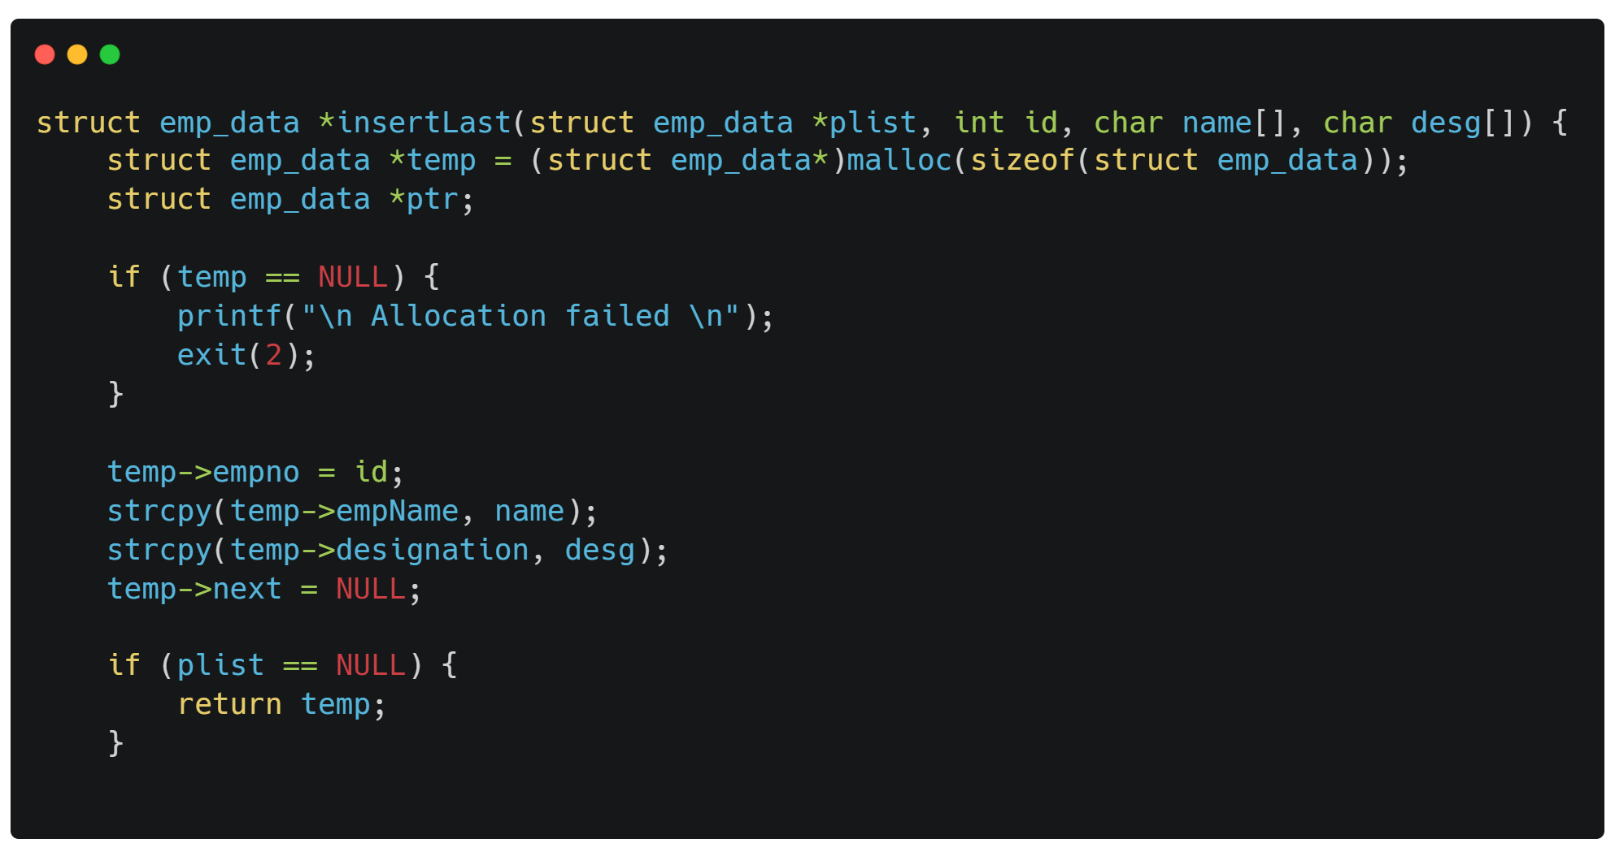
04
Source code using C\C++

Slide 17
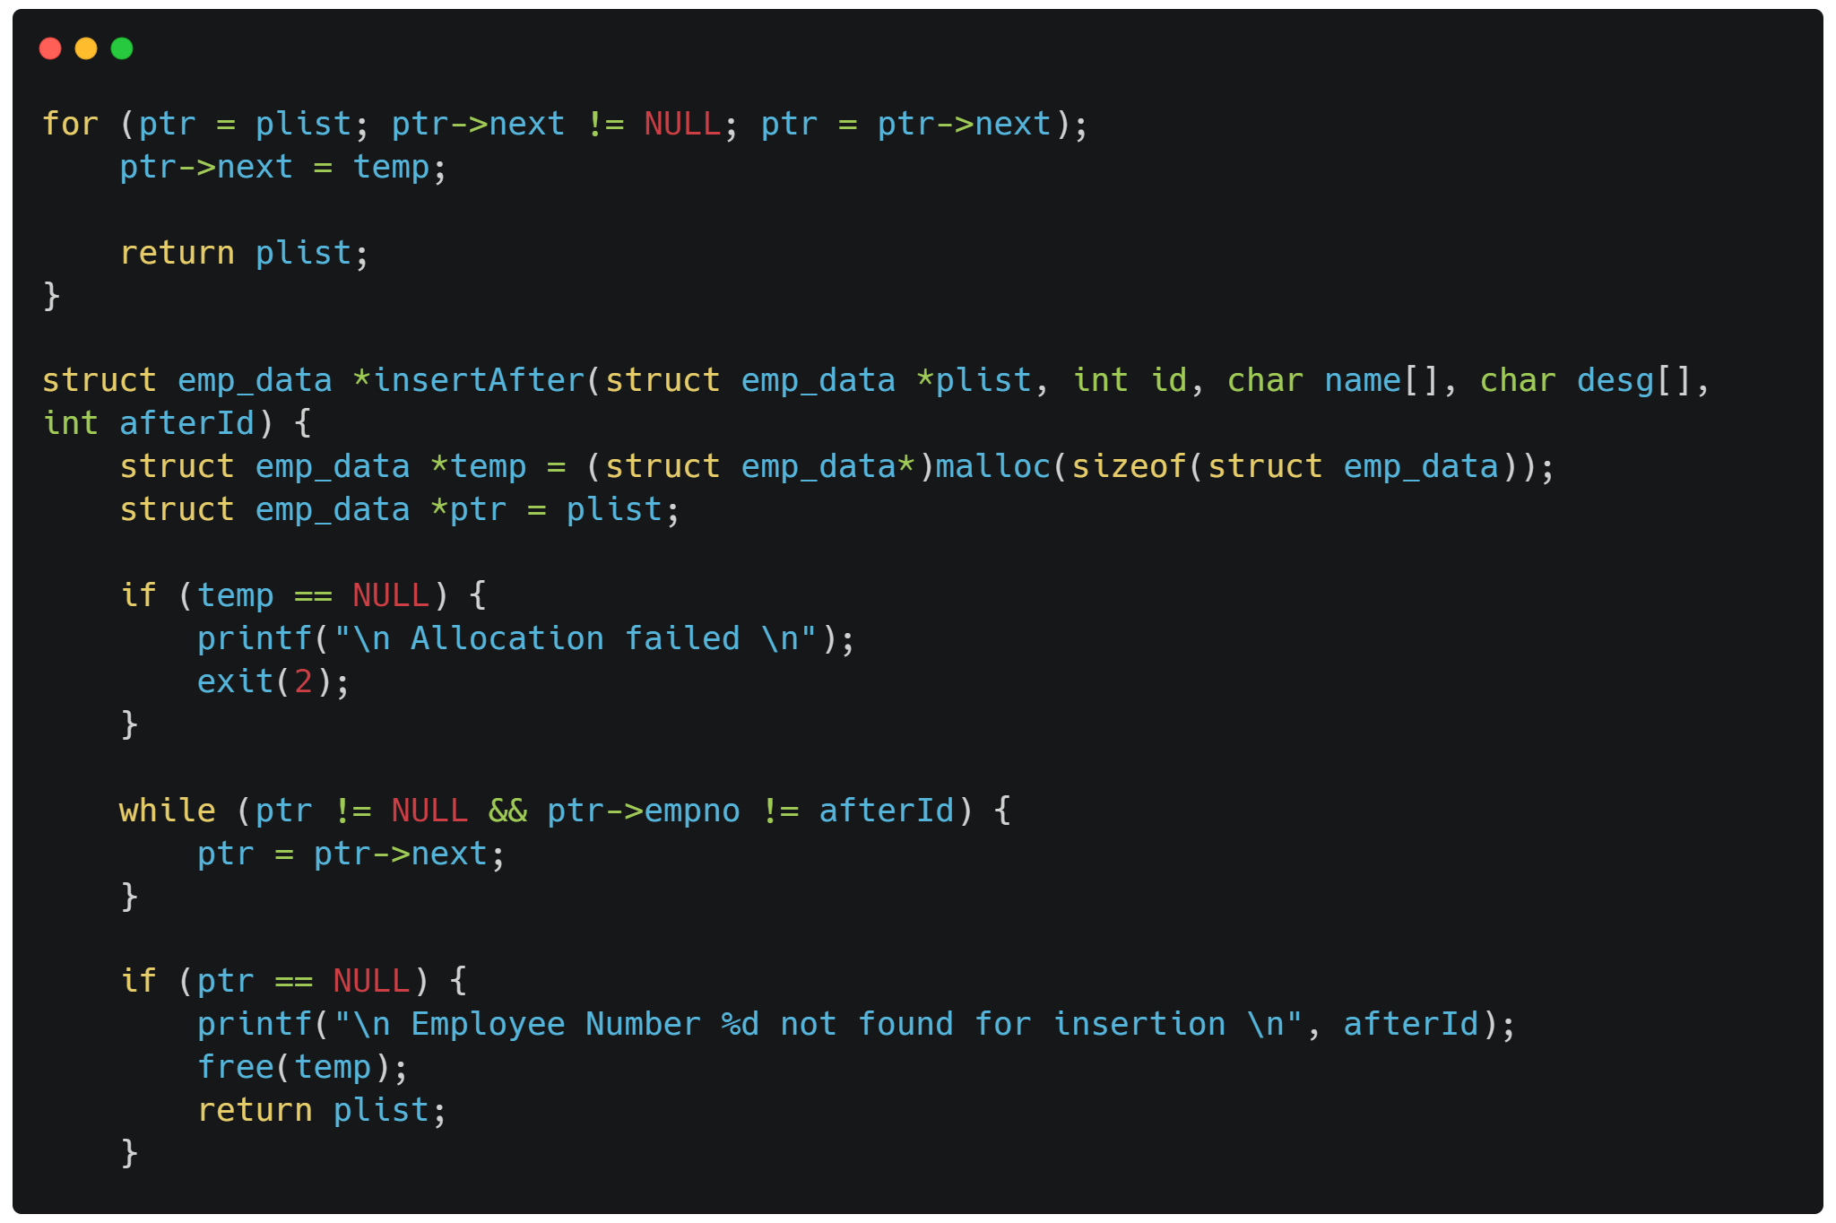
04
Source code using C\C++

Slide 18
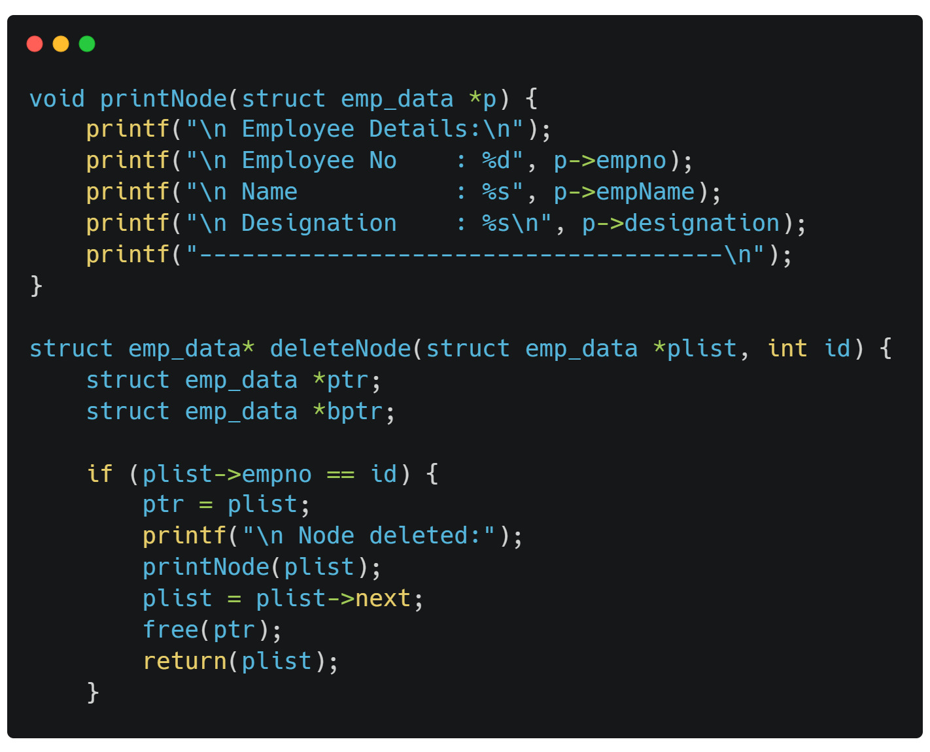
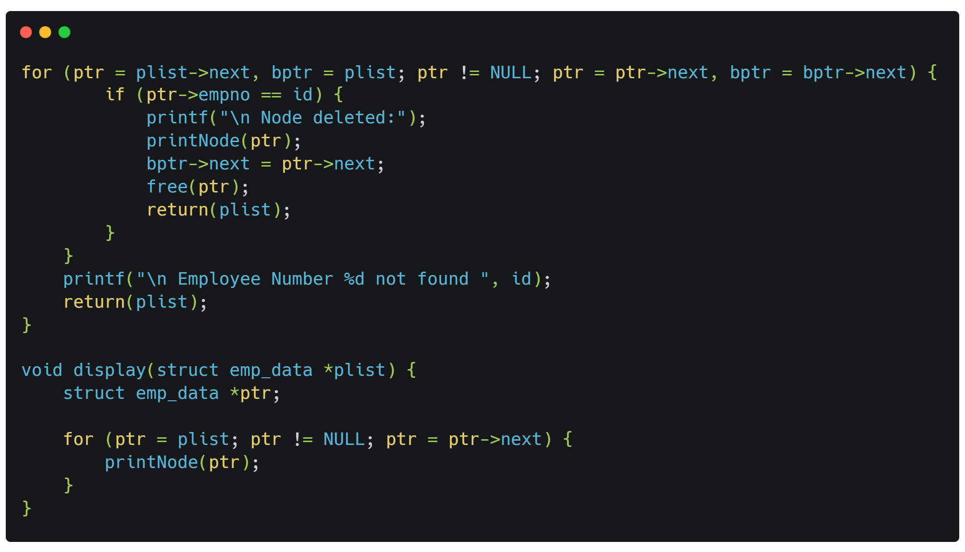
04
Source code using C\C++

Slide 19
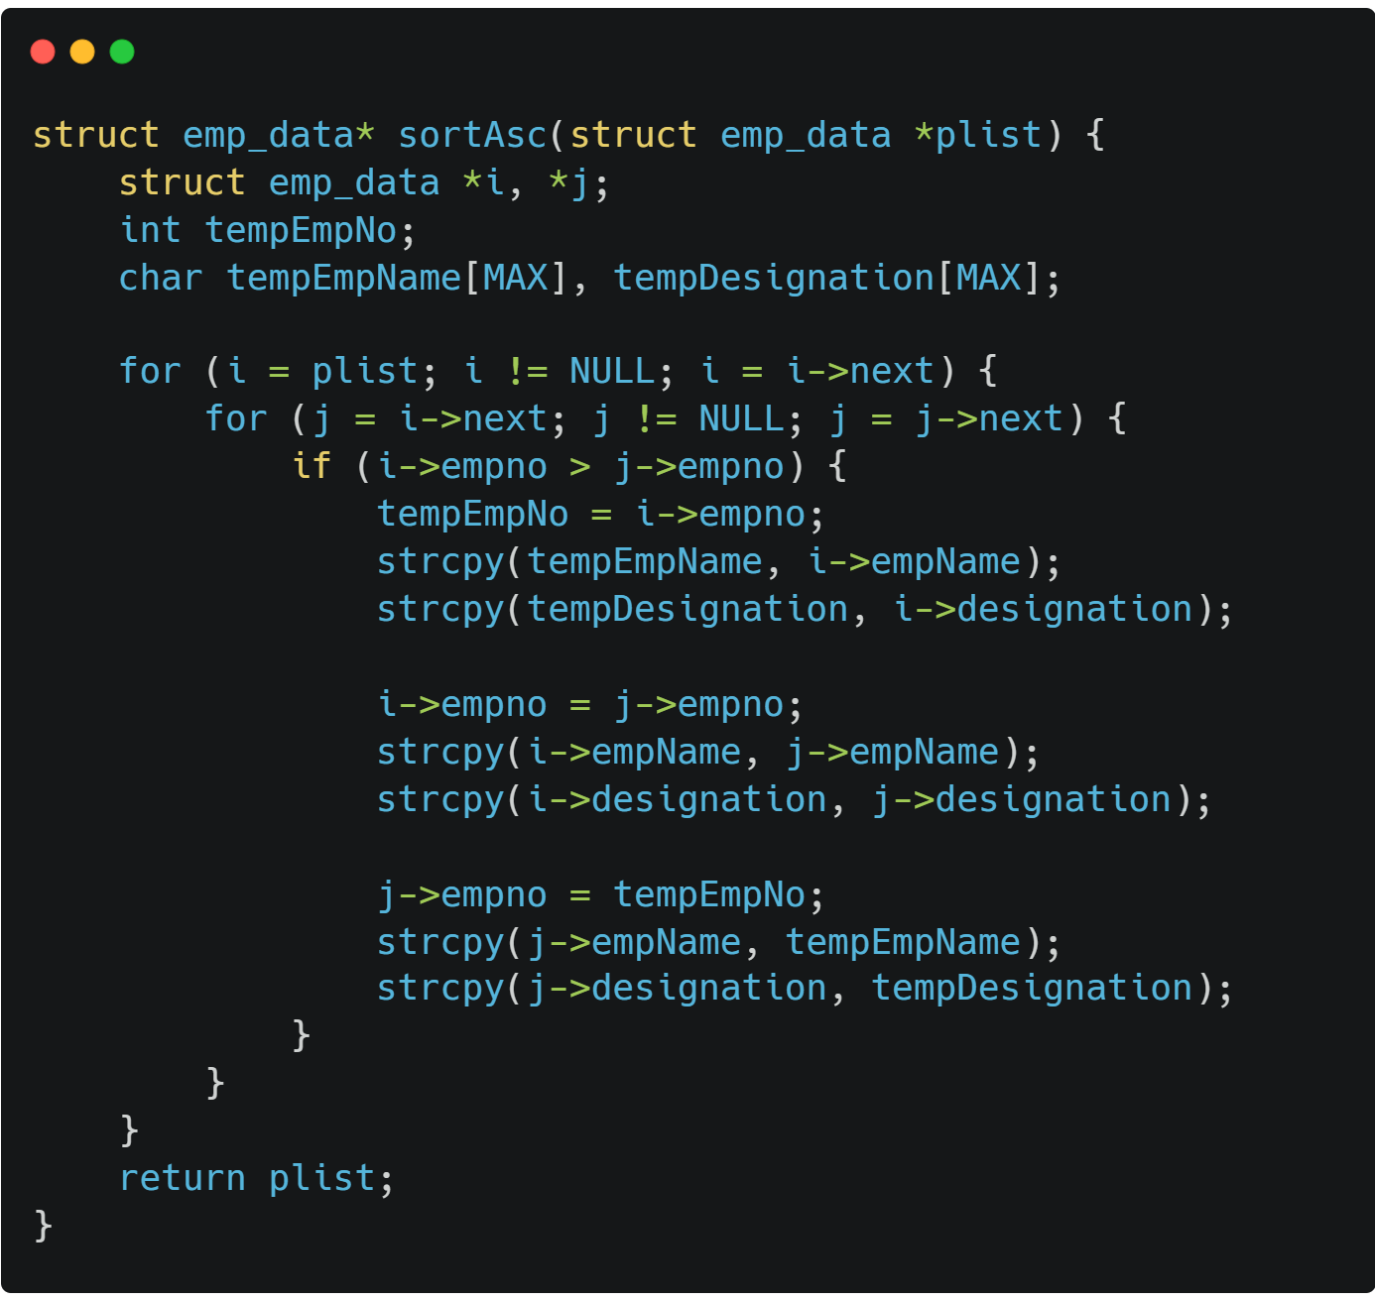
04
Source code using C\C++

Slide 20
04
Source code using C\C++

Slide 21
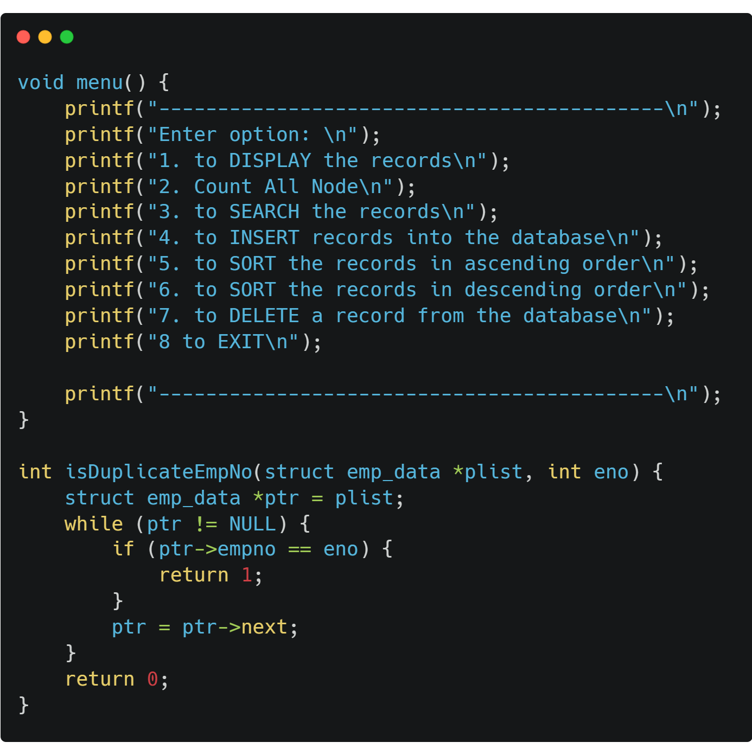
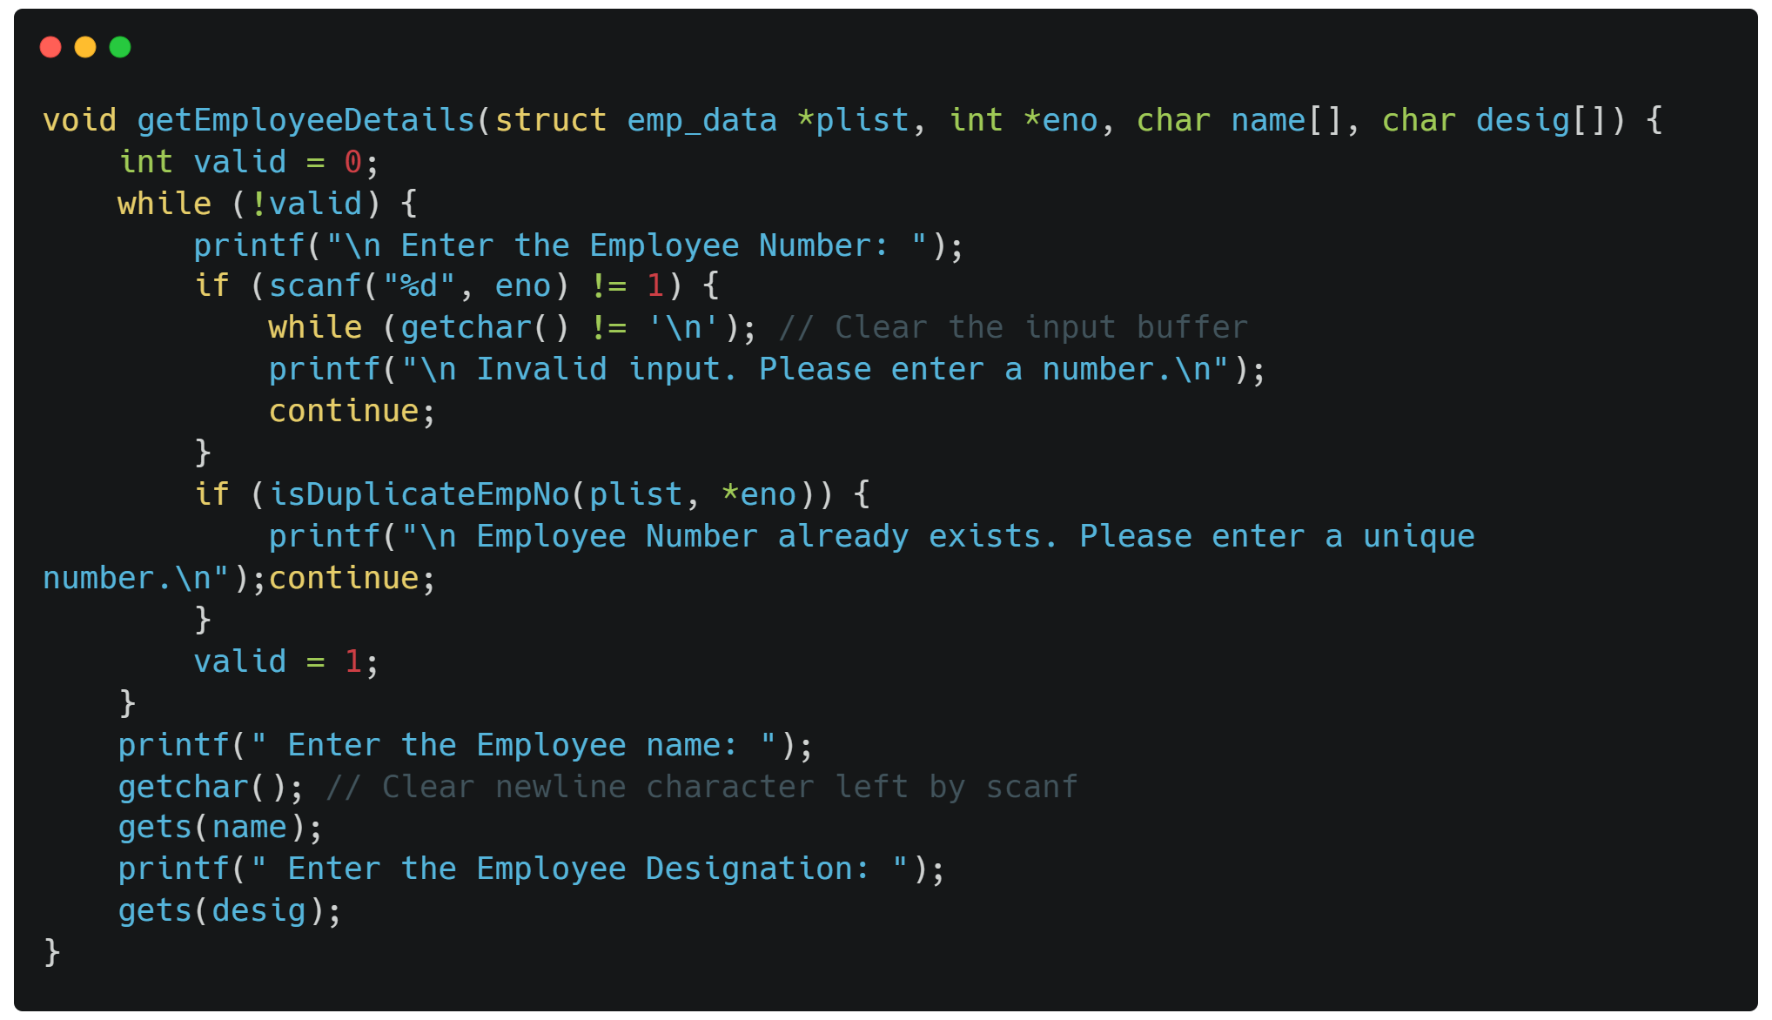
04
Source code using C\C++

Slide 22
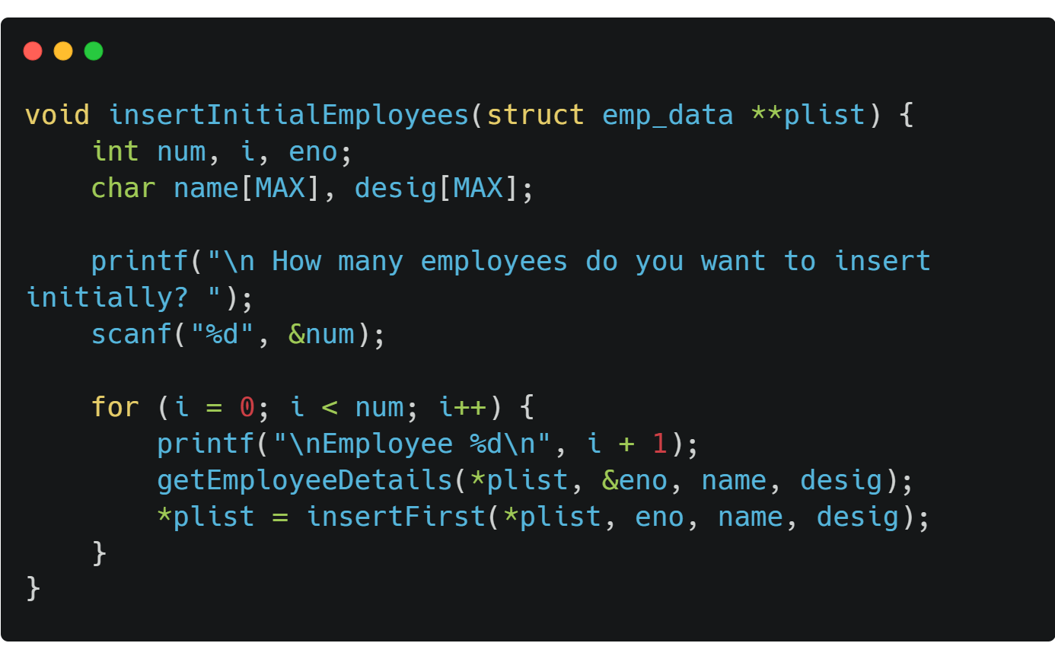
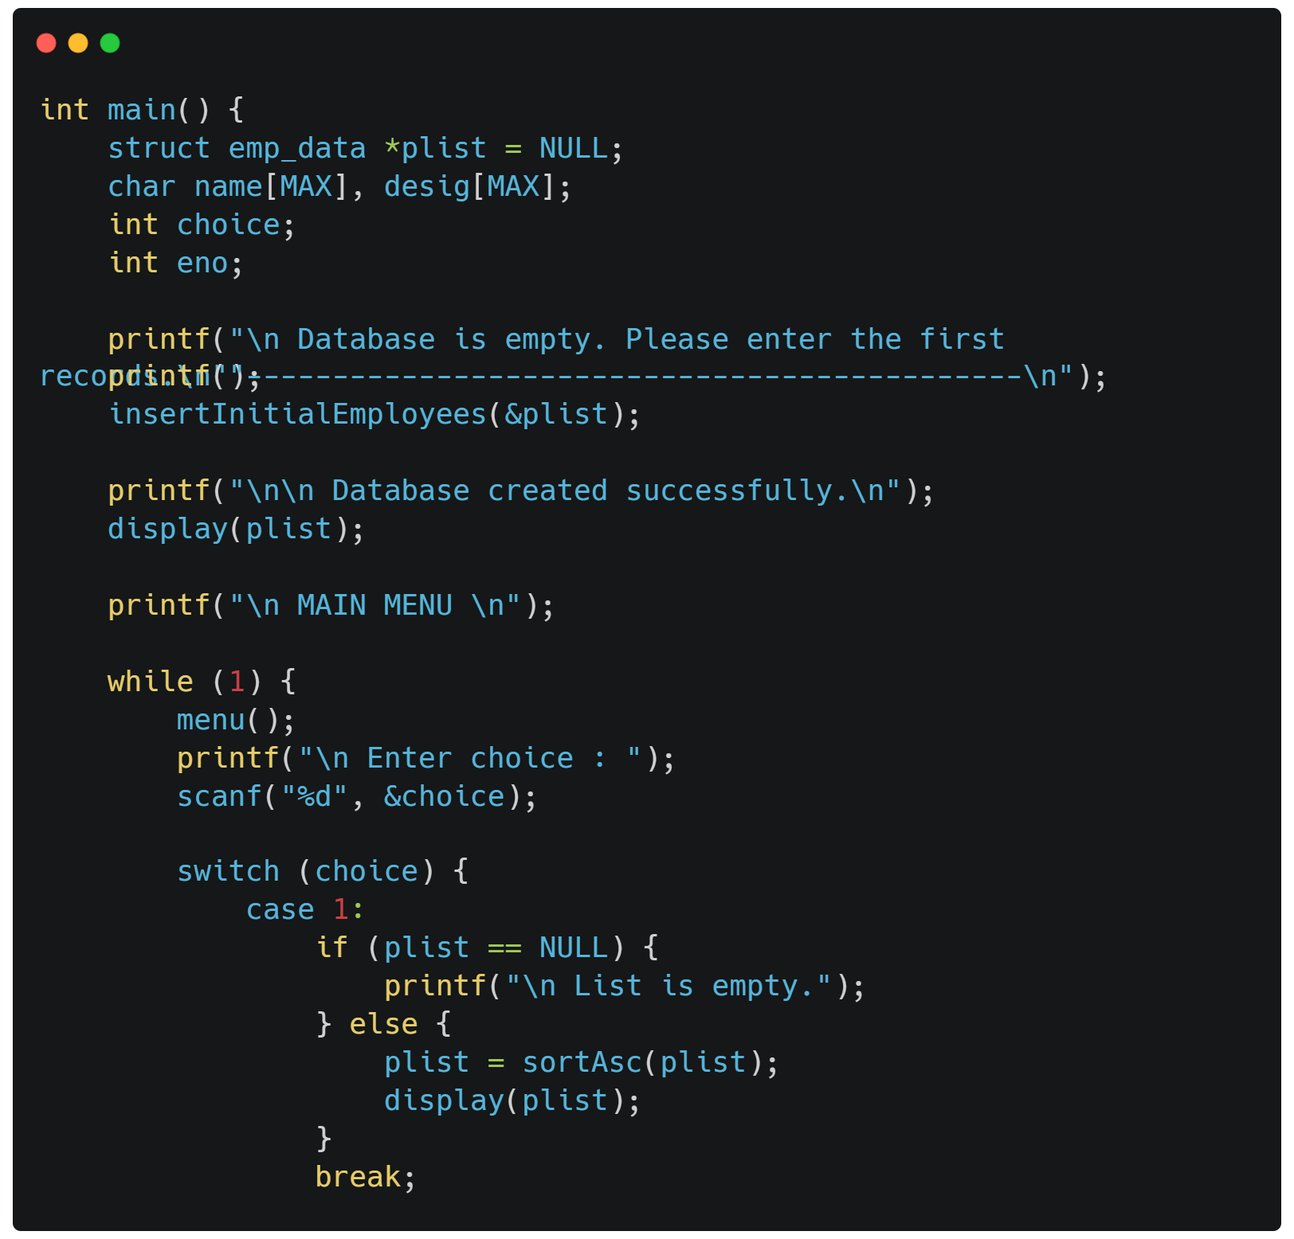
04
Source code using C\C++

Slide 23
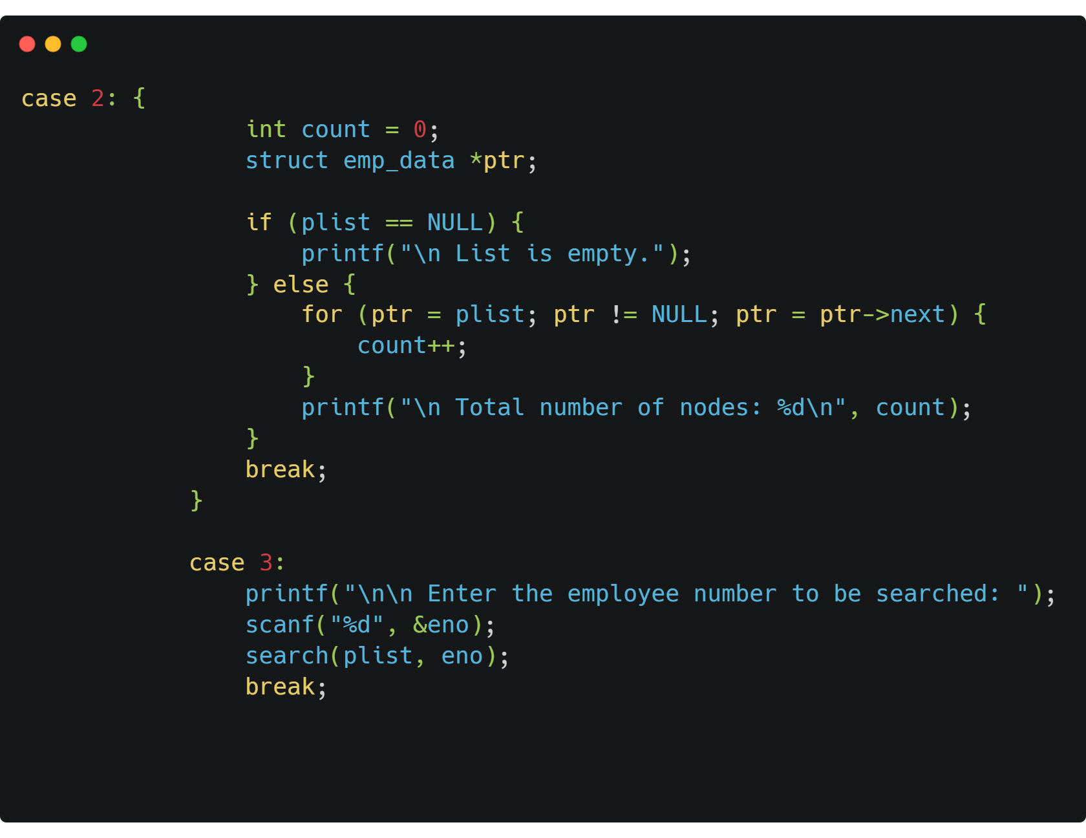
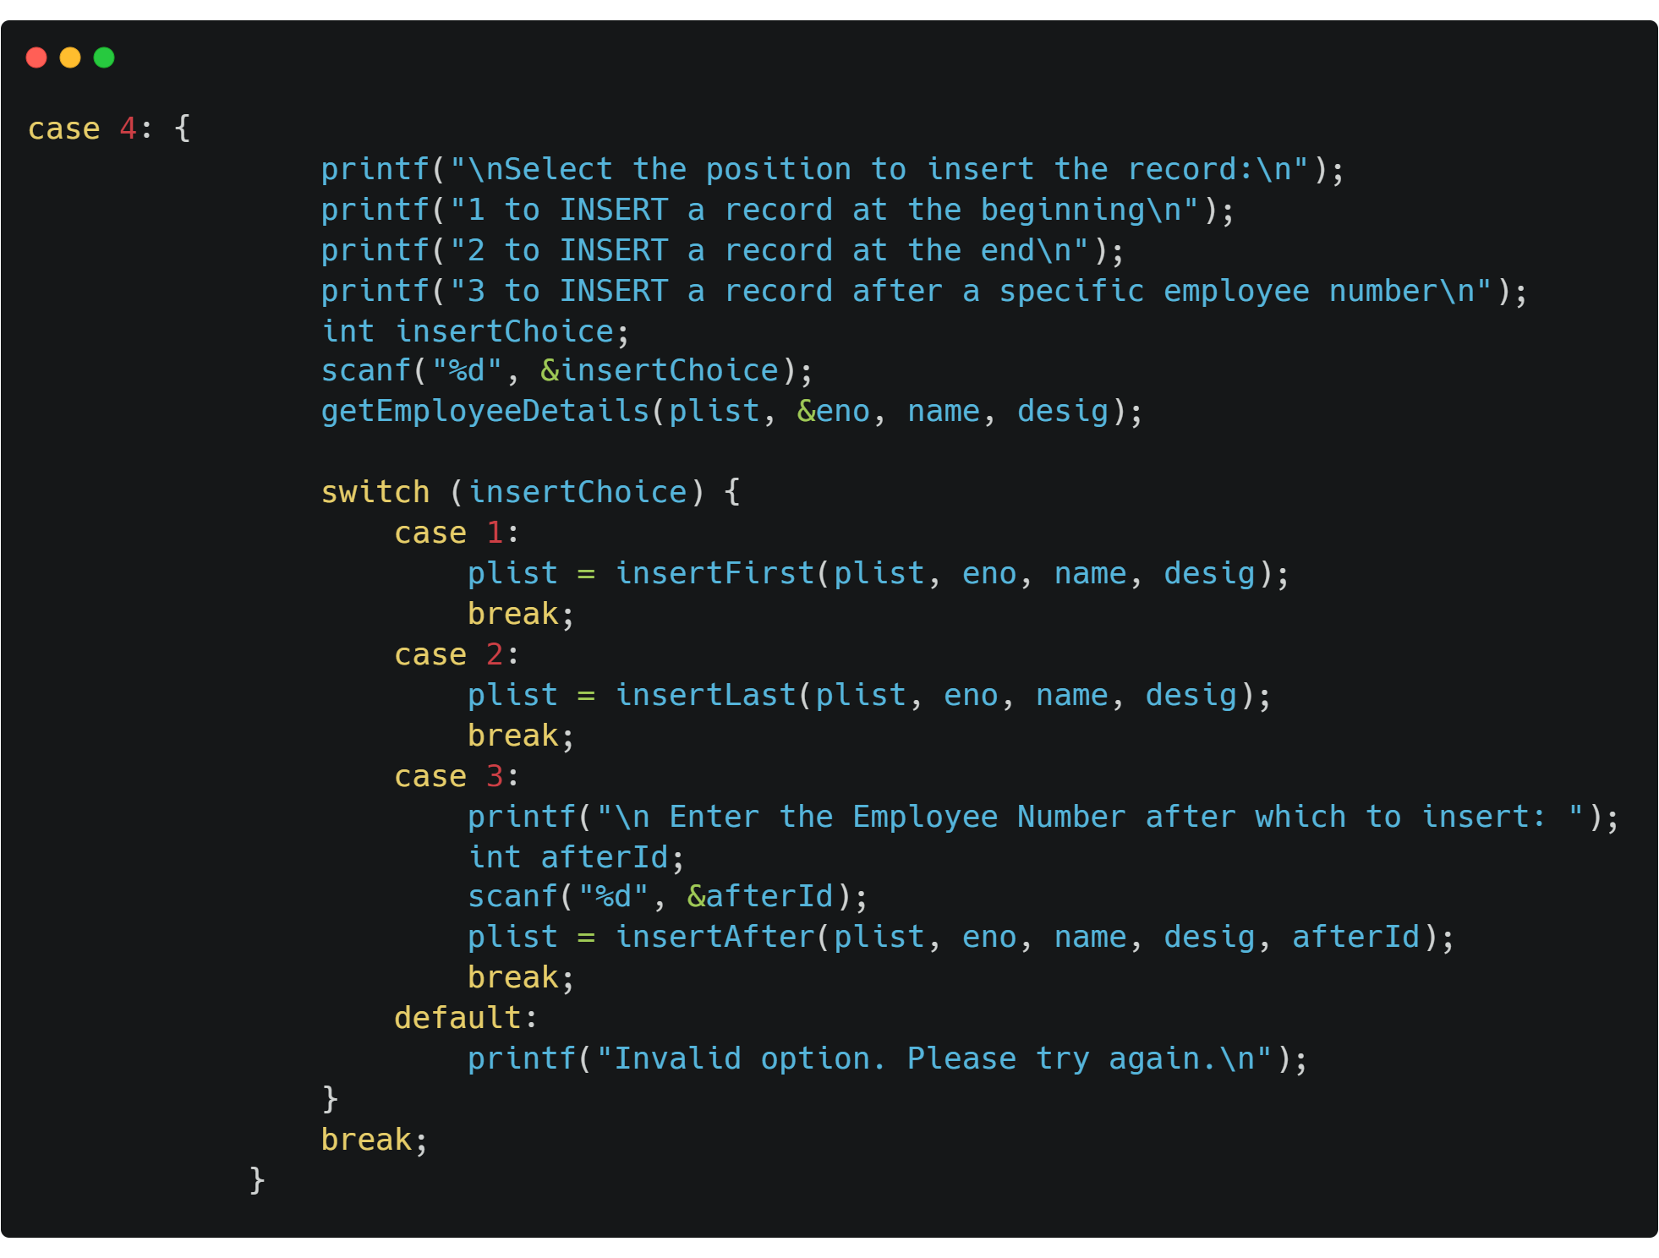
04
Source code using C\C++

Slide 24
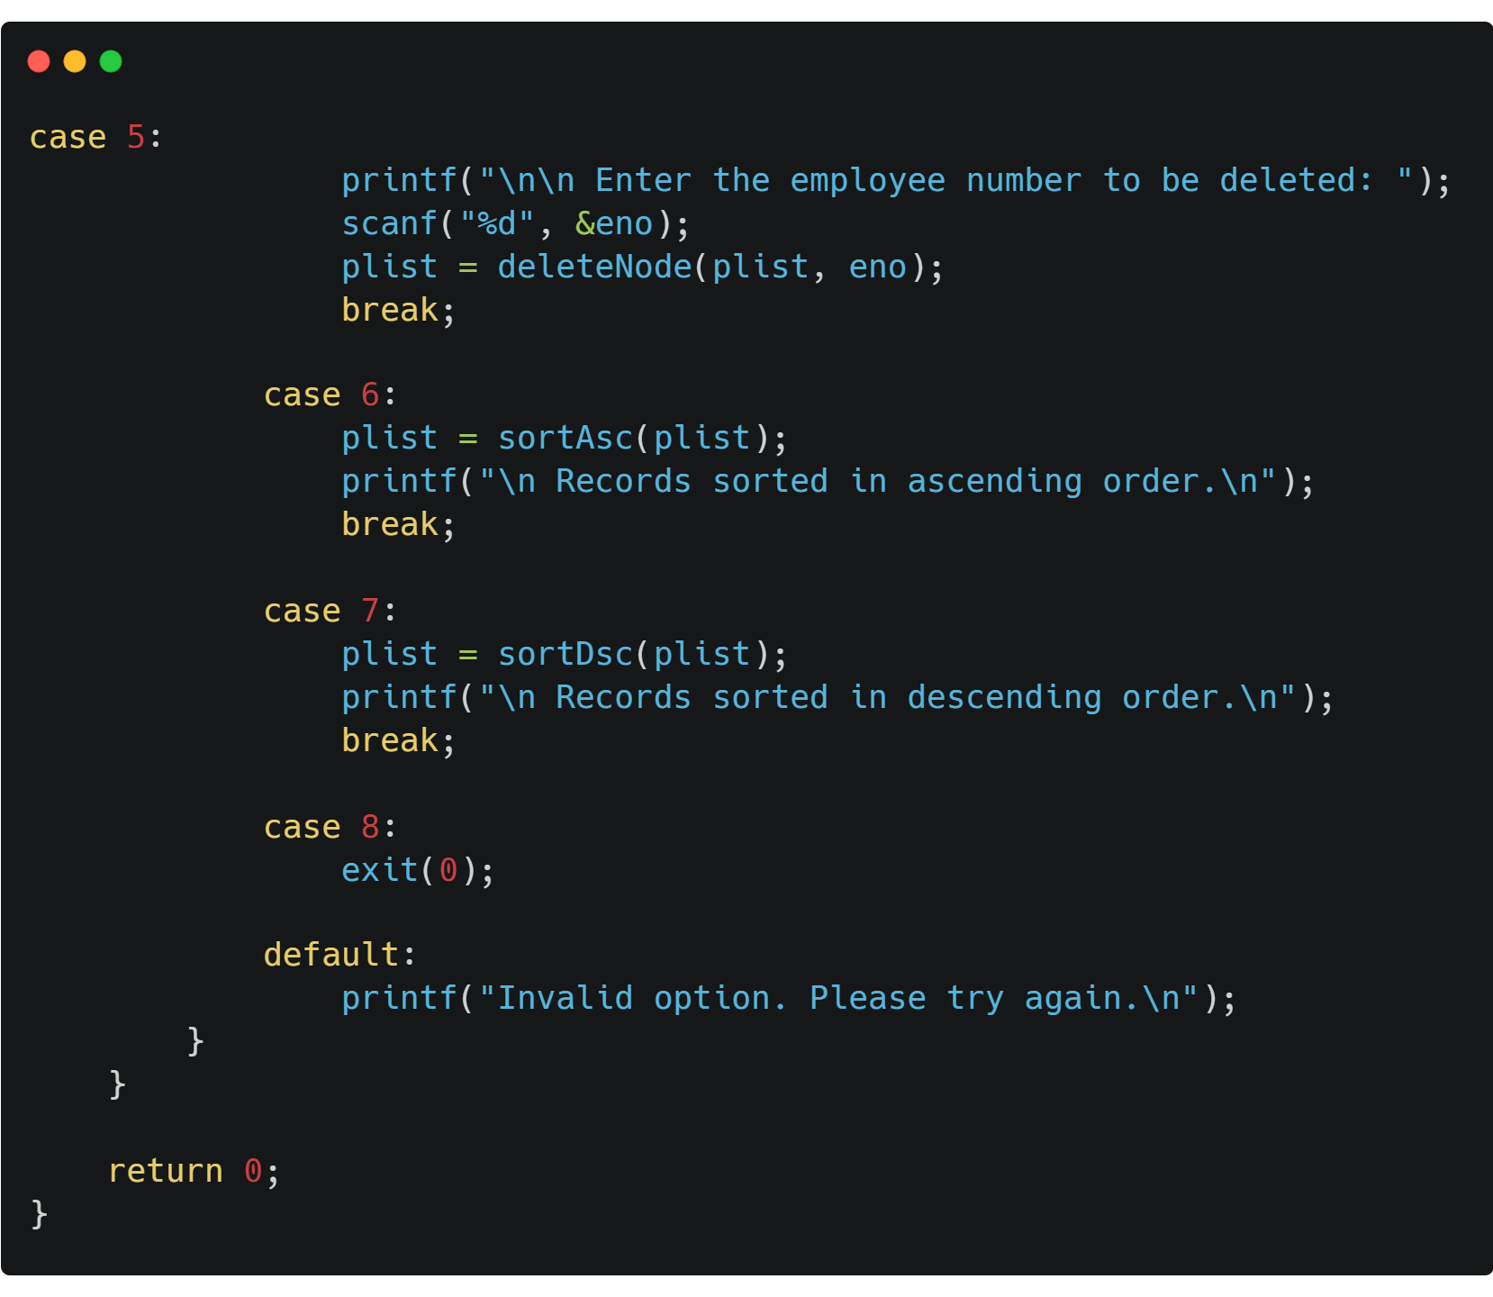
04
Source code using C\C++

Slide 25
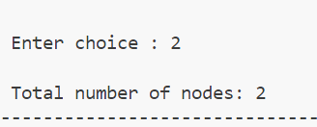
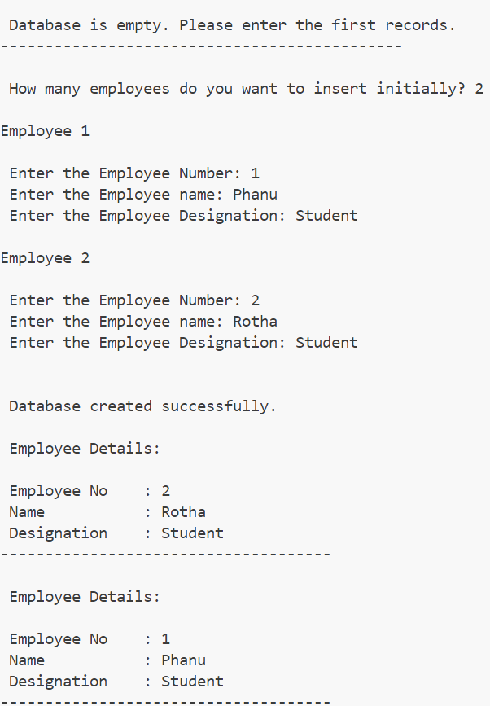
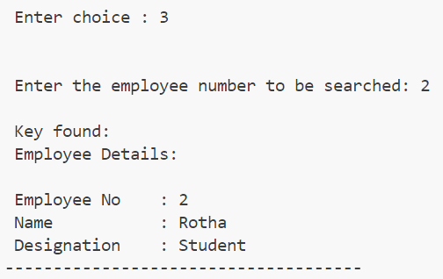
OUTPUT

Slide 26
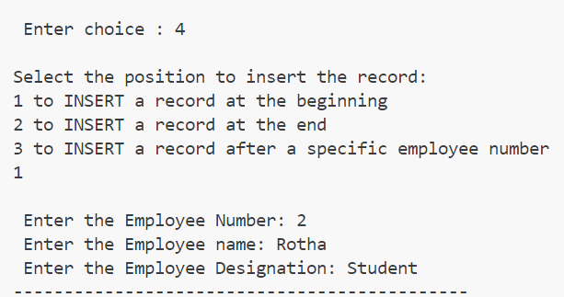
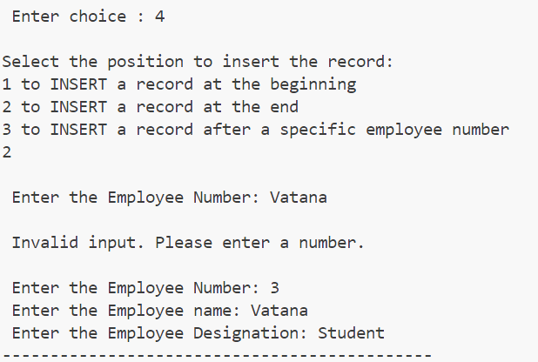
OUTPUT

Slide 27
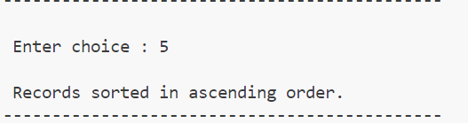
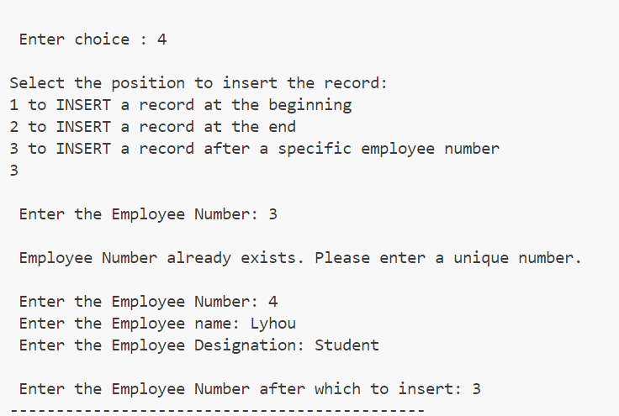
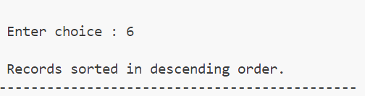
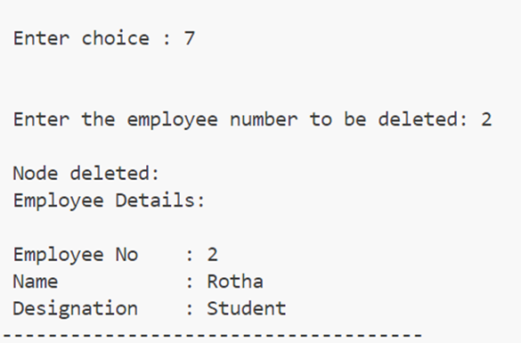
OUTPUT

Slide 28
THANKS

